Slide 1
Carl Rogers Annual Birthday Conference January 28-31, 2015, San Diego, CA – USA Person-centered Approach to Self & PCA mission
Orlov, Alexander National Research University Higher School of Economics,
Psychology Department
Russian Federation
Higher School of Economics , Moscow, 2015
www.hse.ru

Slide 2
Part I: PCA to Self
Introduction:
traditionally, the Self is defined as a result of a process of individualization (individuality)
PCA to Self means that it’s a result of a process of self-actualization (individuation in Jung’s terms) or an individity

Slide 3
Traditional approach
Self as Individuality / Personality:
“façade” & “shadow”
inner war
(in white & black)

Slide 4
Person-centered approach
Self as Individity / Essence:
internal, core, intuitive, positive, unprotected
part of Personality
inner peace
(in yellow)

Slide 5
The main features of individity
numinous (transpersonal) experiences
sensitivity
openness to experience
authenticity (congruence)
ability to love

Slide 6
Human being’ Self
is characterized by same qualities (Rogers, 2001; see Baldwin, 1987):
unconditional positive regard,
empathic understanding,
congruent self-expression,
altered (unconditional) states of consciousness,
presence in any situation by intuitive, positive, essential characteristics.

Slide 7
Conclusion
Psychology as a natural science discipline does not have any sufficient descriptive tools for characterizing of a Self
Even PCA therapists (who do not treat their clients as objects) realize that up to now they lack in language to describe a Self
As soon as PCA therapists, wishing to understand the essential principles of a person’s Self, takes a step away from traditional approach to Self as a personality (an individuality) they immediately step into terra incognita
We would like to light up the very first step on such a way
Every journey begins with a first step

Slide 8
Part II: PCA mission
Introduction
Understanding of PCA mission is important:
consolidation of PCA
vision of PCA main purpose
fulfillment of PCA itself

Slide 9
My idea
To ask PCA people all over the world on PCA mission via
docs.google.com

Slide 10
Questionare
Enter your age *
- 30
31 - 40
41 - 50
51 - 60
61 - 70
71 - 80
81 -
Choose your gender *
male
female
Enter the country of your permanent residence *
Enter your main professional position *
psychologist
counsellor
psychotherapist
educationist
artist
coach
mediator
other:
Enter the duration of your informal association with PCA (in years) *
- 5
6 - 10
11 - 15
16 - 20
21 - 25
26 - 30
31 -
Enter a mission of PCA *
counselling
psychotherapy
facilitation
education
coaching
mediation
peacemaking
other:

Slide 11
Sample
N=50 Country of permanent residence
1. Brazil | 3
2. Hong Kong | 1
3. Hungary | 1
4. Germany | 1
5. Japan | 2
6. Kazakhstan | 2
7. Mexico | 2
8. Portugal | 1
9. Romania | 6
10. Russia | 25
11. Spain | 1
12. UK | 1
13. USA | 4

Slide 12
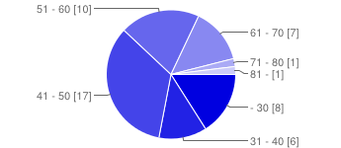
Age

Slide 13
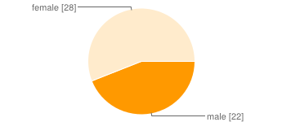
Gender

Slide 14
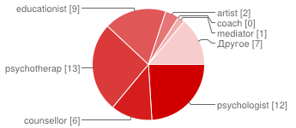
Professional position

Slide 15
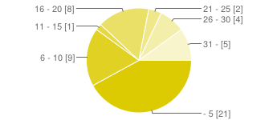
Association with PCA (in years)

Slide 16
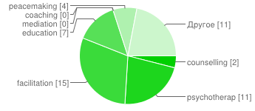
PCA mission

Slide 17
What’s a mission?
Two metaphorical answers:
alpha & omega
seed & fruit

Slide 18
Carl Rogers’ mission
Peacemaking (1977-
-------------------------------------------------------------------------
Facilitation (1970-
Education (1969-
Psychotherapy (1942-
Counseling (1939-
-------------------------------------------------------------------------Peacemaking (1922-

Slide 19
These were his way and his mission
What are yours?
Let’s try to answer on this question
in terms of “The Parable of the Fig tree”

Slide 20
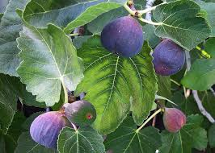
Choice: leaves vs. fruits

Slide 21
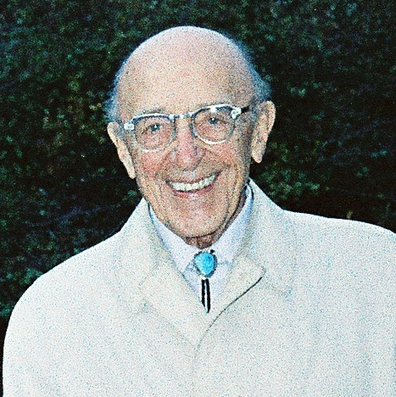
He knows, he smiles…
1986

Slide 22
Thank you for your attention!
Higher School of Economics , Moscow, 2015
www.hse.ru

